Slide 1
Augmenting and innovating evidence-based and promising employment services to increase vocational recovery among people with psychiatric conditions
E. Sally Rogers, Sc.D.
Executive Director and Research Professor; Co-PI RRTC
Marianne Farkas, Director of TDTA and Clinical Professor, Co-PI RRTC
This conference presentation is supported in part under a grant with funding from the National Institute on Disability, Independent Living, and Rehabilitation Research, and from the Center for Mental Health Services Substance Abuse and Mental Health Services Administration, United States Department of Health and Human Services (NIDILRR grant 90RT5029). NIDILRR is a Center within the Administration for Community Living (ACL), Department of Health and Human Services (HHS). The contents of this conference do not necessarily represent the policy of NIDILRR, ACL, HHS, or of SAMHSA and you should not assume endorsement by the Federal Government.

Slide 2
Center for Psychiatric Rehabilitation

Slide 3
Center for Psychiatric Rehabilitation
First RRTC funded by the National Institute on Disability, Independent Living and Rehabilitation Research (NIDILRR) on psychiatric disabilities in 1979
Previously, psychiatric disabilities were considered to have only a downward trajectory— “You will never recover”—”You will never work.”
Founding principle: Like other individuals with disabilities, individuals with psychiatric conditions can benefit from rehabilitation services to address needed skills and supports
Mission has remained the same:

Slide 4
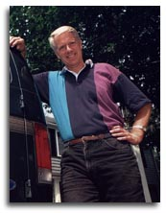
Video of William Anthony discussing the shift to a recovery focus.

Slide 5
Guiding Vision of Recovery-Bill Anthony
Recovery is described as “a deeply personal, unique process of changing one’s attitudes, values, feelings, goals, skills, and/or roles….a way of living a satisfying, hopeful, and contributing life...”
“Recovery transcends illness and the disability field itself. Recovery is a truly unifying human experience…. all people…experience the catastrophes of life…[and] the challenge of recovery must be faced.”

Slide 7
Center for Psychiatric Rehabilitation Current Research, Development, Knowledge Translation
https://cpr.bu.edu/
Development of Innovative Services: College Mental Health, Recovery Education Center with health and recovery focus
(Philanthropy)
Testing
Cognitive
Remediation
interventions
(NIMH/
NIDILRR)
Improving Employment
Outcomes RRTC
(NIDILRR/SAMHSA)
Development & Testing Peer led Photovoice: Anti Stigma (NIMH); Community Integration (NIDILRR)
Development of Integrated Scaling Up Approach to EB Employment Practices
(NIDILRR))

Slide 8
Major Trends Affecting Our Work
First: Paradigm shift from “stabilization and maintenance” to recovery and vocational recovery. Reclaiming valued roles (including that of a worker) is central to that.
Second: Developed and tested “supported employment” and “supported education” interventions designed to replace segregated services; “hybrid” models SE/SEd.
Moved away from a linear “train-then-place” approach to “place-and-train”.
Recognized that individuals could live, learn, work and socialize in communities of their choice by enhancing access to programs available to the general public rather than segregated services.
Third: The Center embraced the peer movement and developed participatory approaches and to develop and deliver interventions and services that involved individuals with psychiatric disabilities as trainers, researchers, support specialists.

Slide 9
Supported Employment-Challenges for the field and rationale for our research and knowledge translation:
Jobs obtained through SE do not lead to “decent work”—that is, they are mostly dead end jobs, with no benefits and limited tenure.
SE services not widely available…some estimates are that only a small percentage of individuals who want SE can access it.
Individuals who are ambivalent about work, who lack confidence, or explicit motivation to work are often left behind in SE and IPS services.
New innovations and enhancements needed to engage more the individuals who could work, to improve the IPS outcomes, to address career needs, to scale up.

Slide 10
RRTC Employment Research Projects 2009-2019
Research projects spanning all levels of research: exploratory and descriptive, developmental, intervention testing and scaling up activities.
Several randomized clinical trials of employment related interventions designed to fill the gaps in existing vocational services.
Secondary analyses of existing data sets to better understand predictors of employment success.
Policy studies of adoption of supported employment and “high performing” states with respect to SE.

Slide 11
Employment Augmentations/Initiatives
Vocational Illness Management and Recovery - built on an evidence based intervention – IMR – and designed to assist individuals to cope with symptoms and mental health challenges in the workplace. (Multi-site RCT completed.)
Thinking Skills for Work — A cognitive remediation intervention designed to improve IPS outcomes. (Developed as a tablet application, tested and undergoing a small RCT; multiple earlier trials on TSW suggest beneficial impact on work outcomes).
Hybrid Supported employment and education program -designed to improve continuity of SE and SEd services; results suggest improved engagement in both over time
Vocational Empowerment Photovoice – developed an intervention to empower individuals to pursue work and engage in employment services by enhancing their vocational identity, using the power of Photovoice. (Current multi-site RCT underway. Small completed RCT showed that participation in VEP was associated with a significantly higher rate of engagement in employment services, higher overall empowerment, and lower internalized stigma.

Slide 12
Photovoice Example
My picture is of a wood carved statue of a woman feeling successful. Her arms are extended straight up in the air. She is rejoicing in her success in finally finding herself. When I saw this statue in my cabinet at home, I immediately knew it was the picture I had to write about. This is me today! I have found myself, my career goals, who I am. It has all come together after many years of severe mental illness. Today I feel joy, success, happiness and love like never before in my life.
*Example of Photovoice from the “Vocational Empowerment Photovoice” Project (2009-2018)

Slide 13
Employment Augmentations/Initiatives
Vocational Peer Support - designed to use trained peer specialists to support a person’s vocational recovery and employment goals. (RCT completed; results suggest high satisfaction with intervention and changes in readiness.)
Opening Doors - a group and individually delivered career guidance intervention using mainstream and internet resources. (RCT recently completed.)

Slide 14
State of the Science-2018

Slide 15
Future Directions--RRTC: 2019-2024
The RRTC will:
“Generate new knowledge, generalizable to the relevant target population, designed to better understand barriers to and facilitators of improved employment outcomes, and implement and test models to improve employment outcomes and serve as a national resource center related to improving employment outcomes for people with psychiatric disabilities”

Slide 16
Future Directions in RRTC Research Projects: Addressing the need for access and innovation
Priority 1: Barriers and facilitators of providing access to Individual Placement and Support (IPS) services that are provided with fidelity
Priority 2: Employment outcomes associated with common provider-generated adaptations to IPS
Priority 3: Supports needed to help people…earn a higher income than they currently do with existing employment supports. Research topics may include supports aimed at assisting individuals with navigation of public benefits program as income increases
Priority 4: Supports needed to meet the range of vocational needs…which may include but are not limited to IPS services (including IPS service combined with complimentary supports) and supported education

Slide 17
Future Directions-RRTC Research 2019-2024
R-1: A qualitative study of barriers and facilitators to accessing high fidelity IPS from the perspectives of multiple stakeholders
Explore/Describe
R-2: Development of a typology of provider-generated adaptations of IPS
Descriptive
R-3: A study of provider generated adaptations of IPS using performance-based incentives to reduce staff turnover and improve client outcomes
Explore/Describe

Slide 18
RRTC Research Projects
R-4: A pilot randomized trial of evidence-based (cognitive) self-management strategies for employment success delivered by IPS Specialists
R-6: FastTrack: Enhancing IPS services with a career guidance + supported education intervention to improve work outcomes and earnings
Effectiveness/RCT
Scaling Up
R-5: Mastering the World of Work: Development and testing of a work-focused metacognitive intervention to improve employment outcomes
Effectiveness/RCT
Intervention Dev./Effectiveness

Slide 19
Knowledge Translation—2009-2019
Distance learning initiatives.
Workforce Development for peers and state VR counselors, among others.
Online technical assistance approach to improve vocational recovery services in agencies.
TA to states implementing IPS (in collaboration with Westat).
Heightened focus on employment & developing employment research agenda through National Learning Community, National Summit, and proposed current State of the Science.
Training programs on employment developed for behavioral health providers.

Slide 20
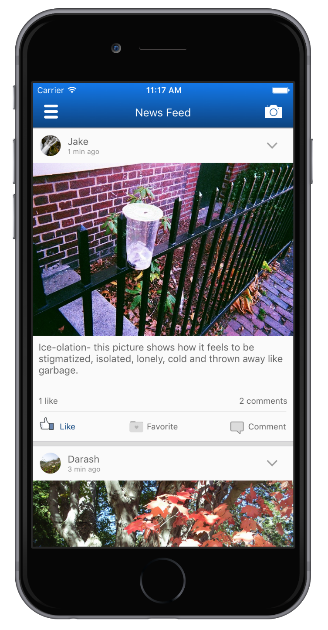
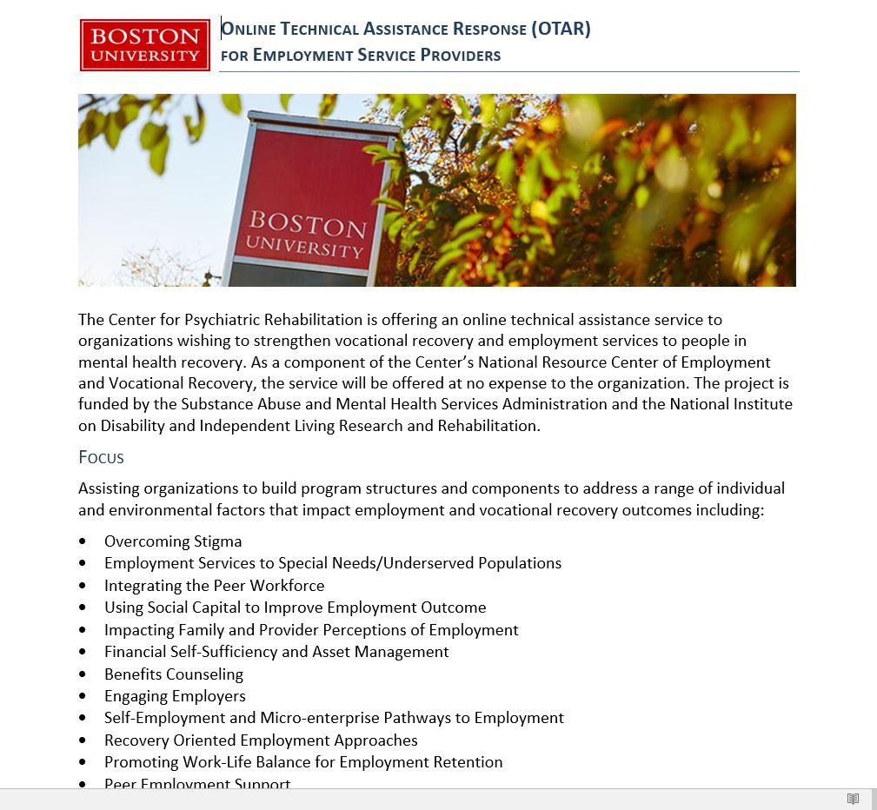
Items encased in blue border are conducted within the jointly funded (NIDILRR and SAMHSA) RRTC

Slide 21
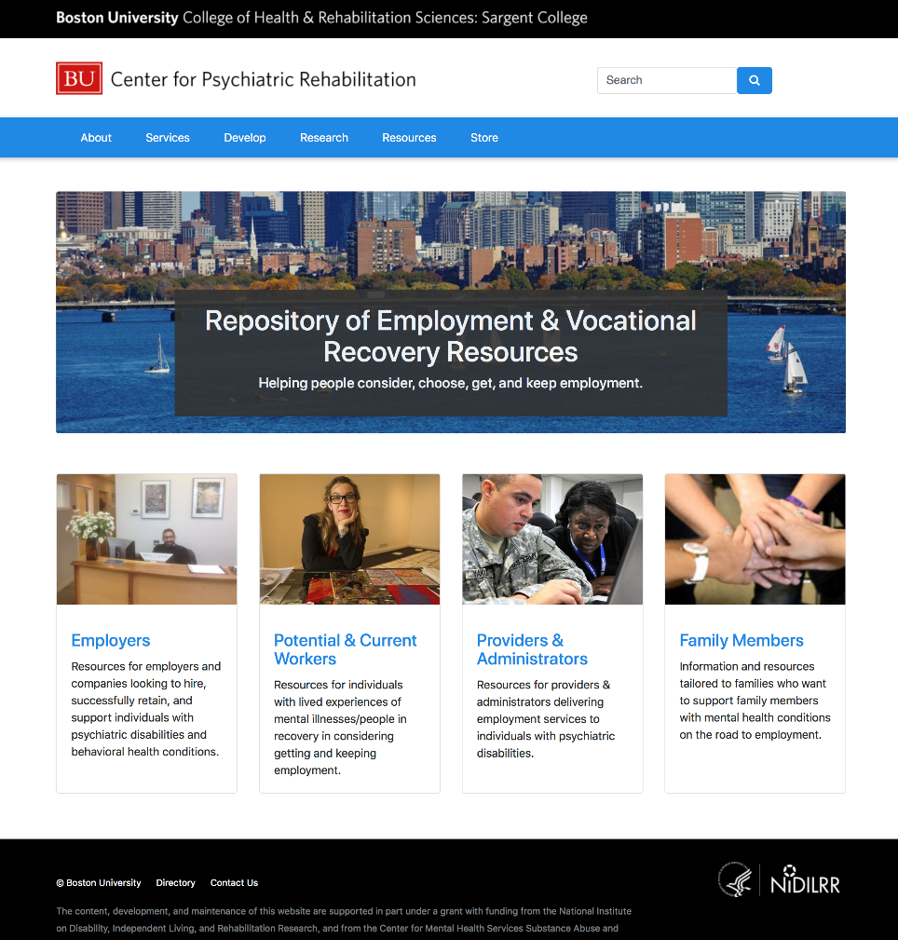
All items are developed and produced within the jointly funded (NIDILRR and SAMHSA) RRTC

Slide 22
RRTC 2019-2024 Future Directions in TDTA
D-1: The National Resource Center on Improving Employment Outcomes: An online push pull dissemination strategy
D-2: Ripple: A Mobile Application to Change Provider Work Expectations
TA-1: Enhanced Online Technical Assistance Response (E-OTAR) Model: Helping organizations utilize new knowledge to improve employment outcomes
General TA Activities
TR-1: Rise Up Above Benefits: Changing the Culture, Peer and Practitioner Capacity to Enhance Access to Quality Benefits Counseling
TR-2: Changing Hearts, Minds and Practice: National Resource Center
General Training

Slide 23
Additional Future Directions
Continued innovation around supported employment to address access and effectiveness.
Continued focus on supported education interventions—hybrid models, effectiveness, delivery issues.
Continued focus on health issues that present challenges to recovery.
Promoting community participation through services and intervention development.
Continued focus on sustainability, scaling up, use of web-based technologies
Reducing the “Know-Do” gap of promising/effective services embedded in routine practice.

Slide 24
Other Center Initiatives in health-wellness/community participation/Knowledge Translation
Services for individuals with psychiatric disabilities and health co-morbidities through services programs including Hope and Health and Mindful Eating
Conducting a RCT to study the effects of adding a nurse practitioner to mental health services to improve health outcomes;
Studying the perspectives of individuals with respect to engaging in lifestyle changes
Current DRRP on community participation designed to better assess and address lack of community engagement.
Current DRRP on “Scaling up” of evidence-based employment practices in routine mental health settings.

Slide 25
Services Division-The Recovery Center and College Mental Health
Services as an “incubator” to stimulate innovative ideas for research.
Recovery Center provides courses in physical and psychological wellness, cognitive remediation, employment all in a normalized, non-stigmatizing environment.
Several Services activities have become applications for NIDILRR funding – for example, Mindful Eating and technology projects.
College Mental Health Services to young adults struggling to succeed academically because of mental health challenges.

Slide 26
Contact information
E. Sally Rogers, Sc.D. erogers@bu.edu RRTC Research Projects
Marianne Farkas, Sc.D. mfarkas@bu.edu RRTC TDTA Projects
Zlatka Russinova zlatka@bu.edu VIMR, VEP, Community Participation
Kim Mueser, Ph.D. mueser@bu.edu Thinking Skills for Work, RAISE
Vasudha Gidugu, Ph.D. vasudha@bu.edu VIMR, VEP, Mindful Eating, Lifestyle Factors
Susan McGurk, Ph.D. mcgurk@bu.edu Thinking Skills for Work

